Slide 1
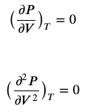

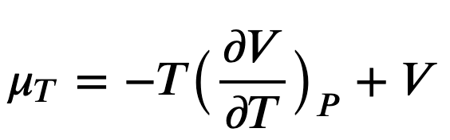


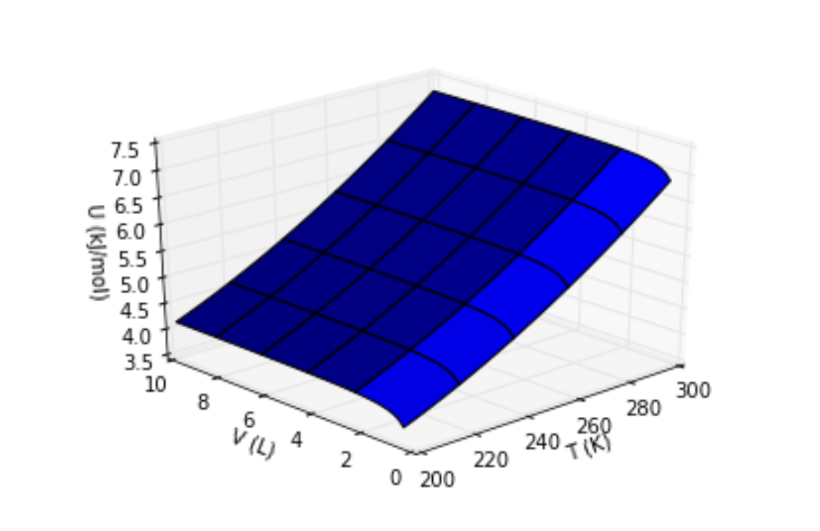
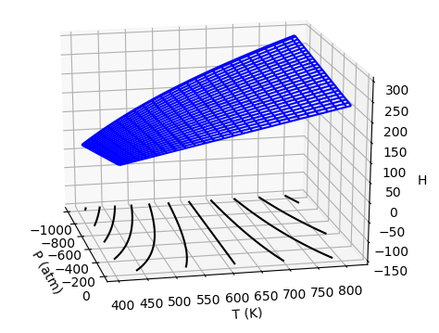
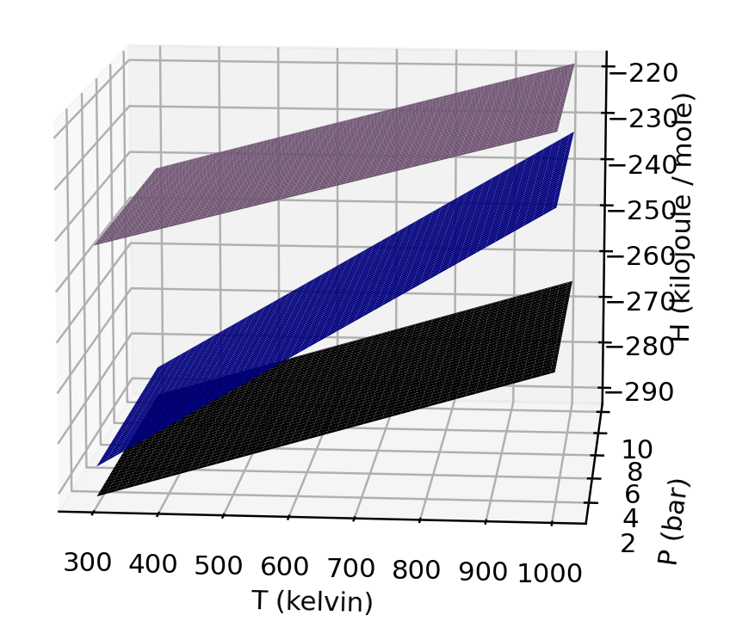
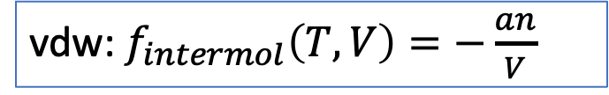

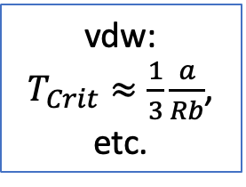



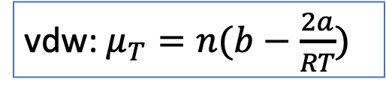
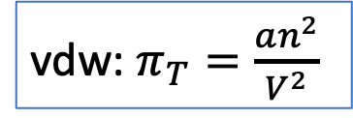
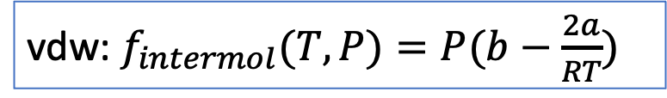
Recap: A roadmap of where we are in our understanding of Thermodynamics
vdw:
$T_{Crit}≈\frac{1}{3}\frac{a}{Rb}$, etc.
$P=P(T,V)$
vdw: $π_{T}=\frac{an^{2}}{V^{2}}$
vdw: $μ_{T}=n(b−\frac{2a}{RT})$
vdw: $f_{intermol}\left(T,V\right)=−\frac{an}{V}$
vdw: $f_{intermol}(T,P)=P(b−\frac{2a}{RT})$
$$U(T,V)$$
$$H(T,P)$$
$$ΔH_{rxn}(T,P)$$

Slide 2
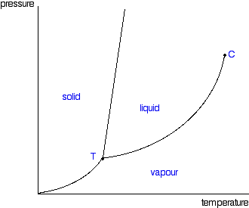

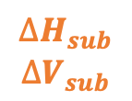
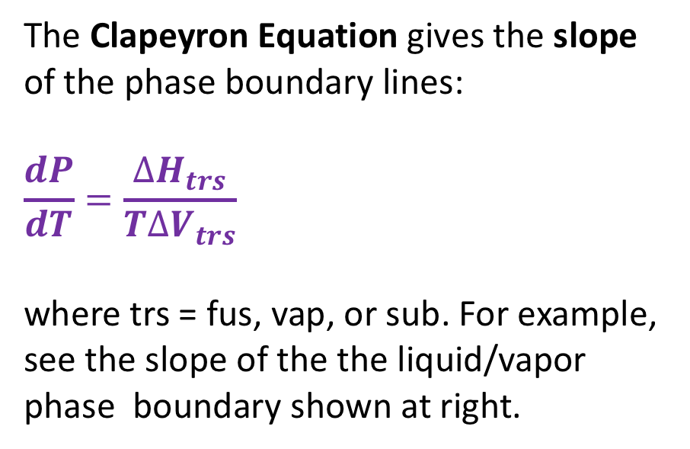
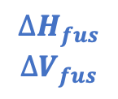

Recap: The Clapeyron equation
The Clapeyron Equation gives the slope of the phase boundary lines:
$$\frac{dP}{dT}=\frac{∆H_{trs}}{T∆V_{trs}}$$
where trs = fus, vap, or sub. For example, see the slope of the the liquid/vapor phase boundary shown at right.
$$∆H_{fus}$$
$$∆V_{fus}$$
$$∆H_{vap}$$
$$∆V_{vap}$$
$$∆H_{vap}$$
$$∆V_{vap}$$
$$∆H_{sub}$$
$$∆V_{sub}$$
We’ll derive this equation later. For now we’ll just use it to obtain expressions for the phase boundary lines themselves – by integrating the slope.

Slide 3
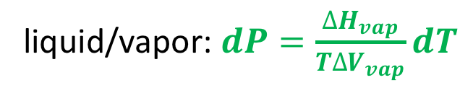
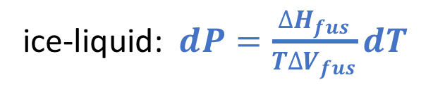
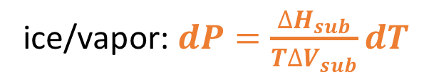
Recap: Integrating the Clapeyron Equation
It makes sense to start integration at the triple point because we know $T_{3}$ and $P_{3}$ very accurately
ice-liquid: $dP=\frac{∆H_{fus}}{T∆V_{fus}}dT$
P
liquid/vapor: $dP=\frac{∆H_{vap}}{T∆V_{vap}}dT$
T
ice/vapor: $dP=\frac{∆H_{sub}}{T∆V_{sub}}dT$

Slide 4
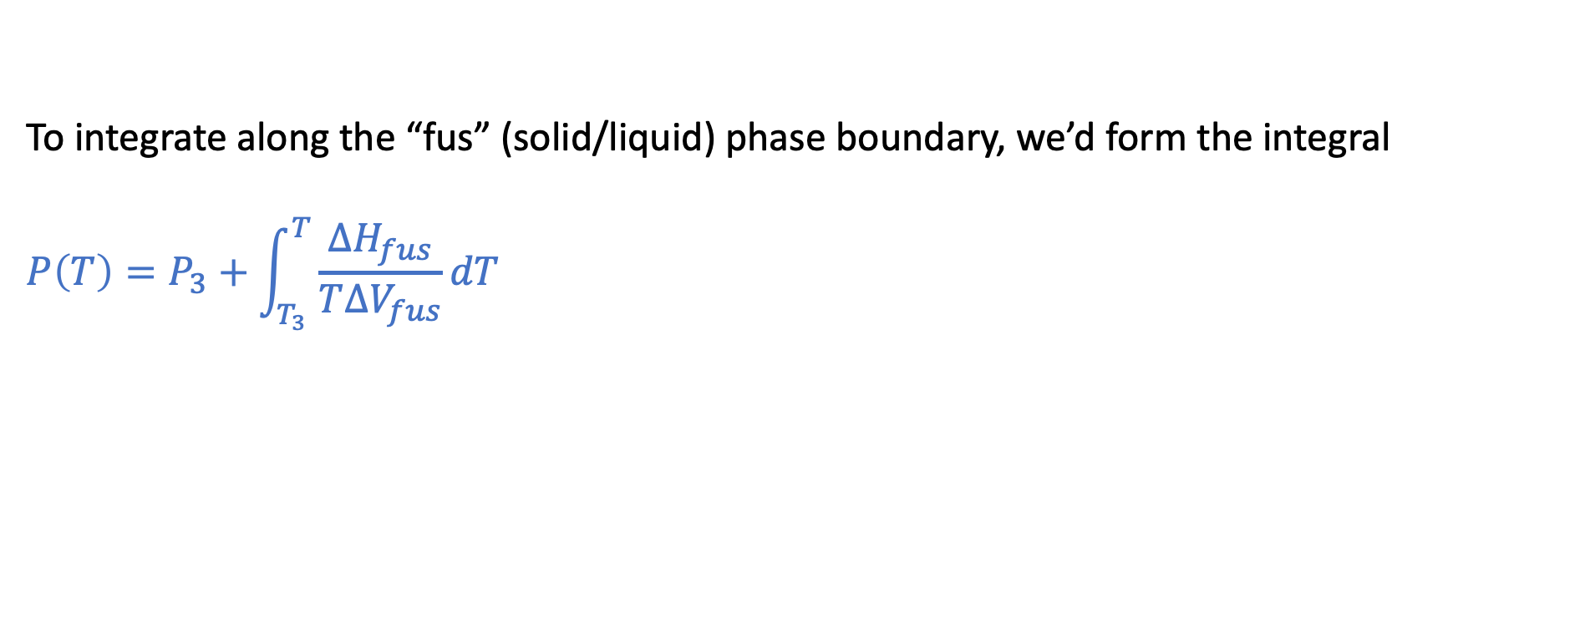
Recap: For example, along the solid/liquid phase boundary
P
T
To integrate along the “fus” (solid/liquid) phase boundary, we’d form the integral
$$P\left(T\right)=P_{3}+\int_{T_{3}}^{T}{\frac{∆H_{fus}}{T∆V_{fus}}dT}$$

Slide 5
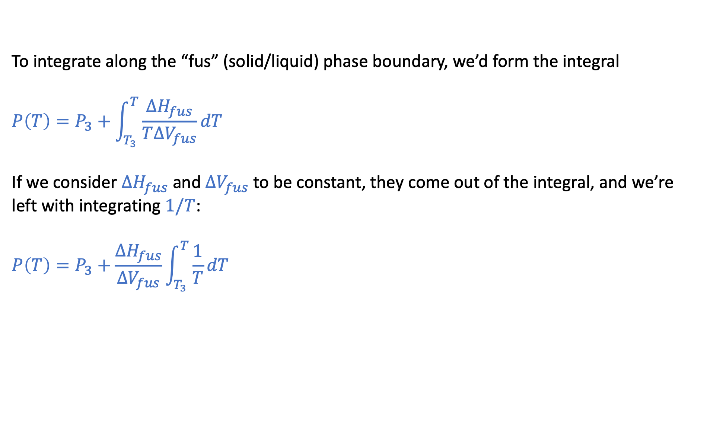
Recap: For example, along the solid/liquid phase boundary
P
T
To integrate along the “fus” (solid/liquid) phase boundary, we’d form the integral
$$P\left(T\right)=P_{3}+\int_{T_{3}}^{T}{\frac{∆H_{fus}}{T∆V_{fus}}dT}$$
If we consider $∆H_{fus}$ and $∆V_{fus}$ to be constant, they come out of the integral, and we’re left with integrating $1/T$:
$$P\left(T\right)=P_{3}+\frac{∆H_{fus}}{∆V_{fus}}\int_{T_{3}}^{T}{\frac{1}{T}dT}$$

Slide 6
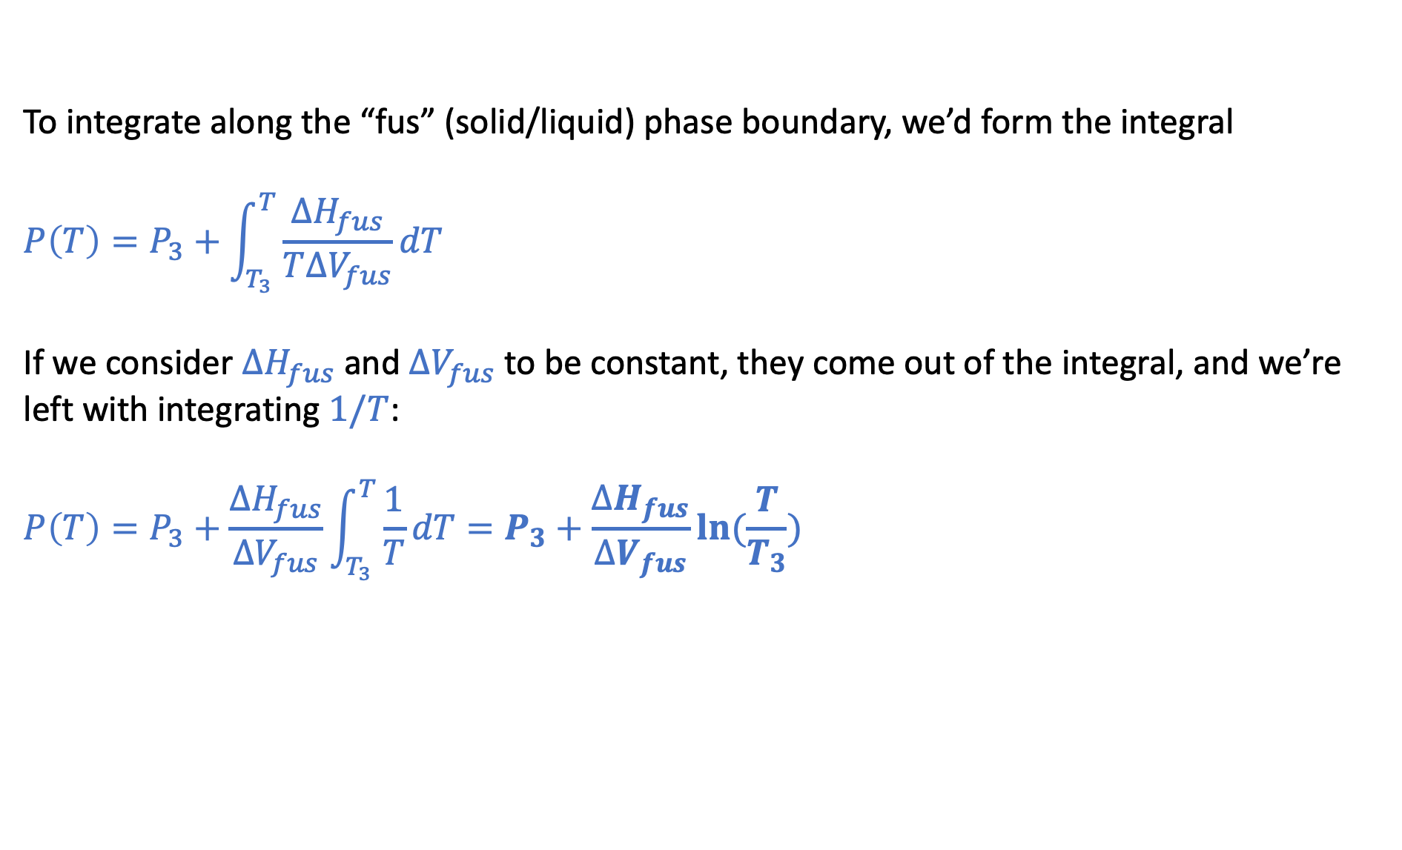
Recap: For example, along the solid/liquid phase boundary
P
T
To integrate along the “fus” (solid/liquid) phase boundary, we’d form the integral
$$P\left(T\right)=P_{3}+\int_{T_{3}}^{T}{\frac{∆H_{fus}}{T∆V_{fus}}dT}$$
If we consider $∆H_{fus}$ and $∆V_{fus}$ to be constant, they come out of the integral, and we’re left with integrating $1/T$:
$$P\left(T\right)=P_{3}+\frac{∆H_{fus}}{∆V_{fus}}\int_{T_{3}}^{T}{\frac{1}{T}dT}=P_{3}+\frac{∆H_{fus}}{∆V_{fus}}ln⁡(\frac{T}{T_{3}})$$
The Thomson Equation

Slide 7
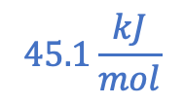
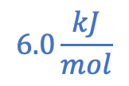
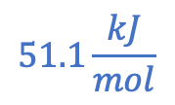
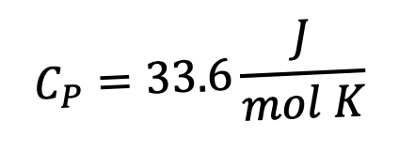

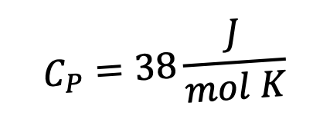



To evaluate $P\left(T\right)=P_{3}+\frac{∆H_{fus}}{∆V_{fus}}ln⁡(\frac{T}{T_{3}})$ … we need the heat required to melt it ($∆H_{fus}$)
$$C_{P}=33.6\frac{J}{mol K}$$
$$ΔH_{vap}$$
H
$$C_{P}=75.4\frac{J}{mol K}$$
$$ΔH_{sub}$$
$$45.1\frac{kJ}{mol}$$
$$51.1\frac{kJ}{mol}$$
$$ΔH_{fus}$$
$$C_{P}=38\frac{J}{mol K}$$
$$6.0\frac{kJ}{mol}$$
273 K
T

Slide 8
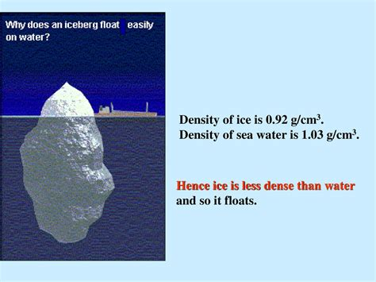
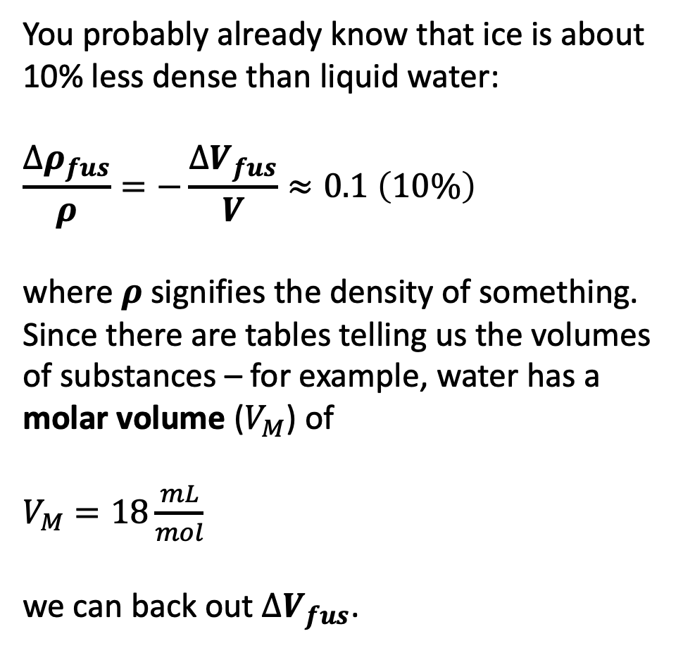
To evaluate $P\left(T\right)=P_{3}+\frac{∆H_{fus}}{∆V_{fus}}ln⁡(\frac{T}{T_{3}})$ … also need the volume change when melting ($∆V_{fus}$)
You probably already know that ice is about 10% less dense than liquid water:
$$\frac{∆ρ_{fus}}{ρ}=−\frac{∆V_{fus}}{V}≈0.1 \left(10\%\right)$$
where $ρ$signifies the density of something. Since there are tables telling us the volumes of substances – for example, water has a molar volume ($V_{M}$) of
$V_{M}=18\frac{mL}{mol}$
we can back out $∆V_{fus}$.

Slide 9
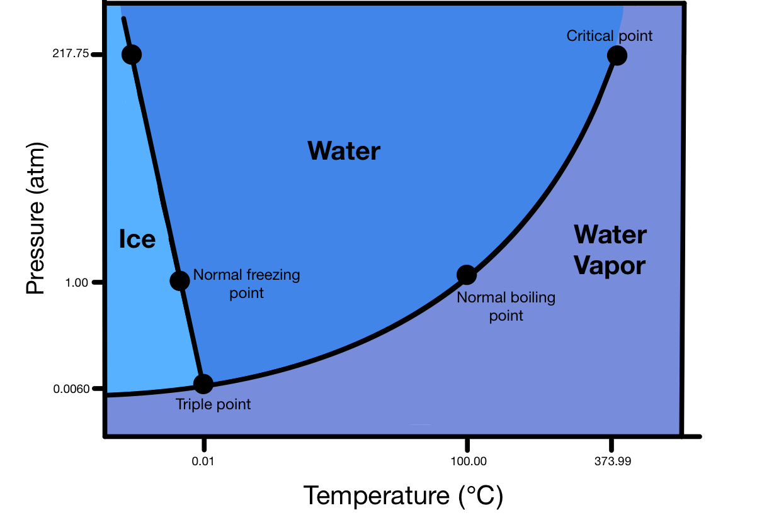
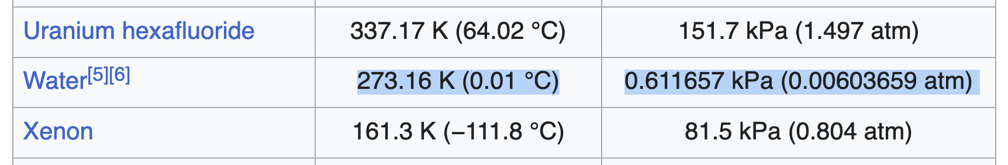


To evaluate $P\left(T\right)=P_{3}+\frac{∆H_{fus}}{∆V_{fus}}ln⁡(\frac{T}{T_{3}})$ … also need the triple point temperature and pressure
From https://en.wikipedia.org/wiki/Triple_point
$$T_{3}$$
$$P_{3}$$

Slide 10


Liquid/vapor phase boundary
P
$$∆H_{vap}$$
$$∆V_{vap}$$
T
For the liquid/vapor boundary, we still start with Clapeyron, $dP=\frac{∆H_{vap}}{T∆V_{vap}}dT$. But there’s a problem: are $∆V_{vap}$ and $∆H_{vap}$ constant along this curve?

Slide 11
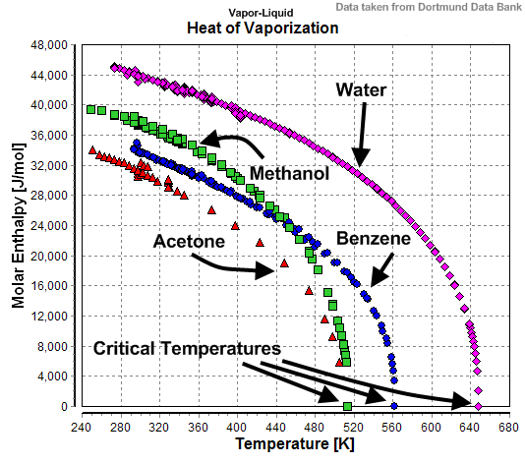
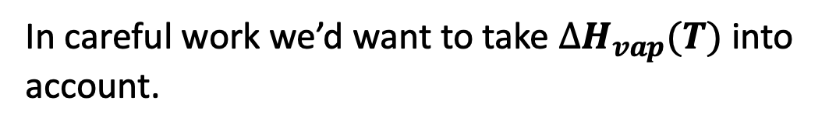
What to do about the temperature-dependence of $∆H_{vap}$?
In careful work we’d want to take $∆H_{vap}(T)$ into account.

Slide 12
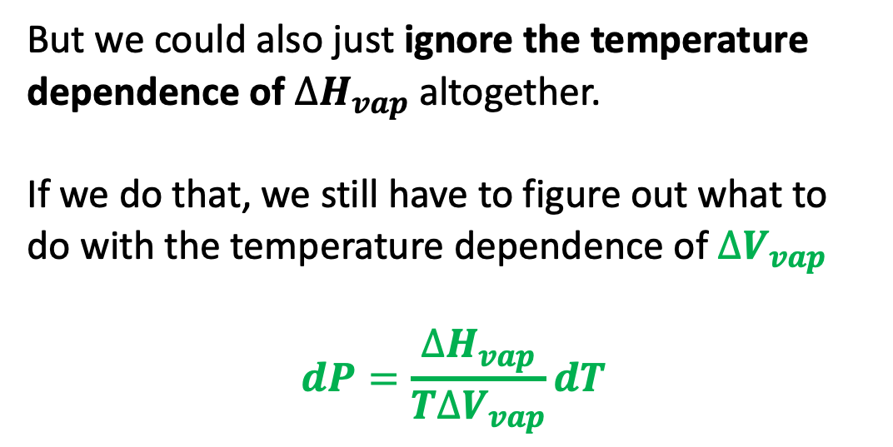
What to do about the temperature-dependence of $∆H_{vap}$?
But we could also just ignore the temperature dependence of $∆H_{vap}$ altogether.
If we do that, we still have to figure out what to do with the temperature dependence of $∆V_{vap}$
$$dP=\frac{∆H_{vap}}{T∆V_{vap}}dT$$

Slide 13
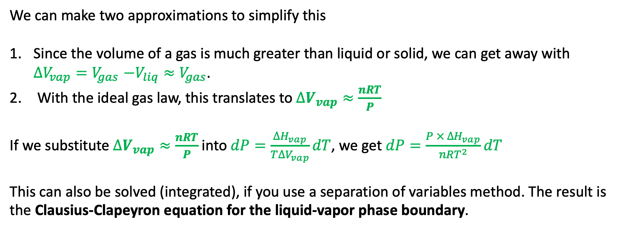
What to do about $∆V_{vap}$ along a liquid-vapor phase boundary …
We can make two approximations to simplify this
Since the volume of a gas is much greater than liquid or solid, we can get away with $∆V_{vap}{=V}_{gas}−V_{liq}≈V_{gas}$.
With the ideal gas law, this translates to $∆V_{vap}≈\frac{nRT}{P}$
If we substitute $∆V_{vap}≈\frac{nRT}{P}$ into $dP=\frac{∆H_{vap}}{T∆V_{vap}}dT$, we get $dP=\frac{P × ∆H_{vap}}{nRT^{2}}dT$
This can also be solved (integrated), if you use a separation of variables method. The result is
the Clausius-Clapeyron equation for the liquid-vapor phase boundary.

Slide 14


The solid/vapor phase boundary
P
For the solid/vapor boundary, all the same considerations apply as to liquid/vapor.
$$∆H_{sub}$$
$$∆V_{sub}$$
T
$$dP=\frac{P × ∆H_{sub}}{nRT^{2}}dT$$

Slide 15
Blackboard work …
$$P=…$$
P
$$P=…$$
T
$$P=…$$

Slide 16

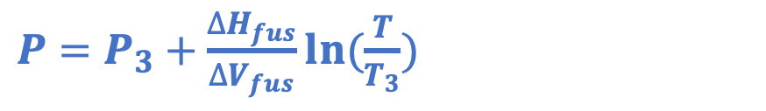
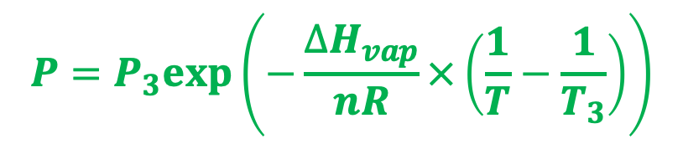
Thomson and Clausius-Clapeyron
$P=P_{3}+\frac{∆H_{fus}}{∆V_{fus}}ln⁡(\frac{T}{T_{3}})$
P
$$P=P_{3}exp⁡\left(−\frac{∆H_{vap}}{nR}×\left(\frac{1}{T}−\frac{1}{T_{3}}\right)\right)$$
T
$P=P_{3}exp⁡\left(−\frac{∆H_{sub}}{nR}×\left(\frac{1}{T}−\frac{1}{T_{3}}\right)\right)$

Slide 17
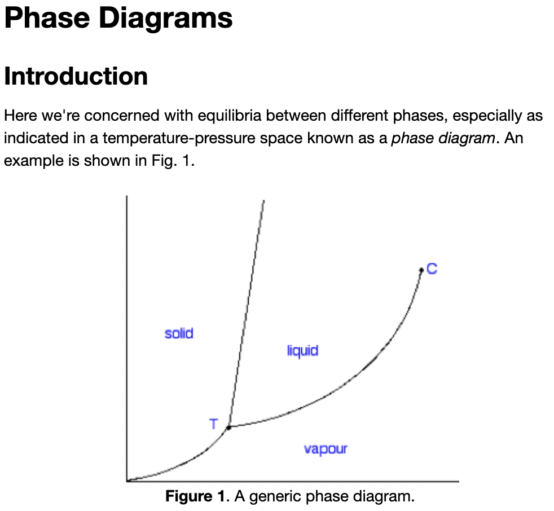
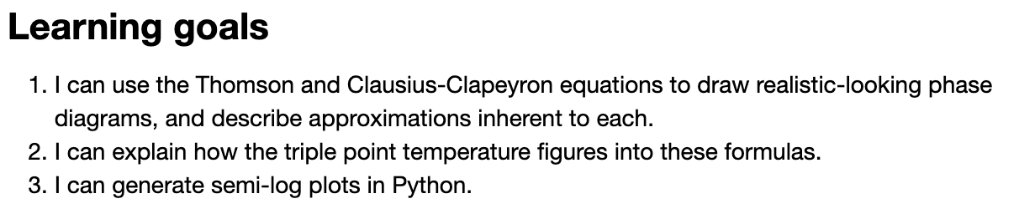
Let’s get started on these ideas in Python …

